Slide 1
zekeLabs
Learning made Simpler ! www.zekeLabs.com

Slide 2
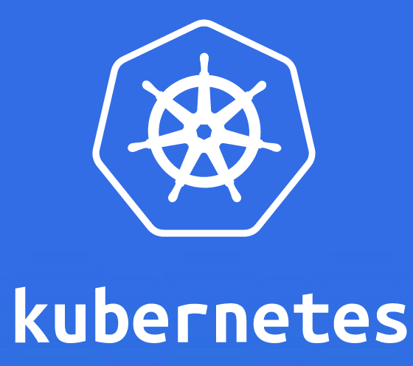

Slide 3
Kubernetes : Services
info@zekeLabs.com | www.zekeLabs.com | +91 8095465880

Slide 4
Service
A Kubernetes Service is a resource to make a single, constant point of entry to a group of pods providing a certain task.
Each service has an IP address and port that never changes while the service exists.
Clients can open connections to that IP and port, and those connections are then routed to one of the pods backing that service.
NO dependency on IP address or name of pod, services are identified by name of the service.
Look into kubia-svc.yaml

Slide 5
Service
In the service.spec (kubia-svc.yaml) :
port: The port this service will be available on, for clients
targetPort: The container port the service will forward to
All pods with the app=kubia label will be part of this service.

Slide 6
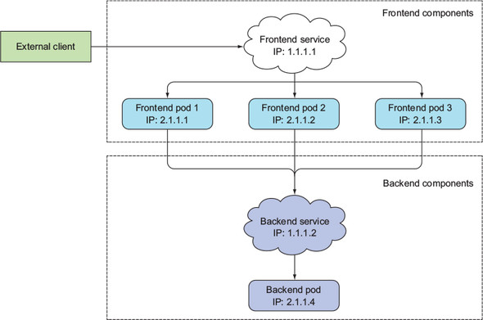
How Services work ?
info@zekeLabs.com | www.zekeLabs.com | +91 8095465880

Slide 7
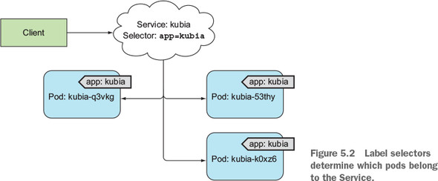
labels define the association
info@zekeLabs.com | www.zekeLabs.com | +91 8095465880

Slide 8
Type of Service
The default is ClusterIP.
ClusterIP: Exposes the service on a cluster-internal IP. Choosing this value makes the service only reachable from within the cluster. The primary purpose of services is exposing groups of pods to other pods in the cluster.
NodePort: Exposes the service on each Node’s IP at a static port (the NodePort). A ClusterIP service, to which the NodePort service will route, is automatically created. You’ll be able to contact the NodePort service, from outside the cluster, by requesting <NodeIP>:<NodePort>.
LoadBalancer: Exposes the service externally using a cloud provider’s load balancer.

Slide 9
Service Discovery
How to know which service is running where ?
Kubernetes also provides ways for client pods to discover a service’s IP and port.
Discovering services through environment variables
Before you can see environment variables for your service, you first need to delete all the pods and let the ReplicationController create new ones.
So that environment variables are set.
kubectl delete po --all
After that run:
kubectl exec <podname> env

Slide 10
Simplest Service: Cluster IP
kubectl create -f kubia-svc.yaml
kubectl get svc
NAME CLUSTER-IP EXTERNAL-IP PORT(S) AGE
kubernetes 10.111.240.1 <none> 443/TCP 30d
kubia 10.111.249.153 <none> 80/TCP 6m
## replace with your pod name and ip
kubectl exec kubia-7nog1 -- curl -s http://10.111.249.153
## 10.111.249.153 will be accessible only from inside the cluster.
info@zekeLabs.com | www.zekeLabs.com | +91 8095465880

Slide 11
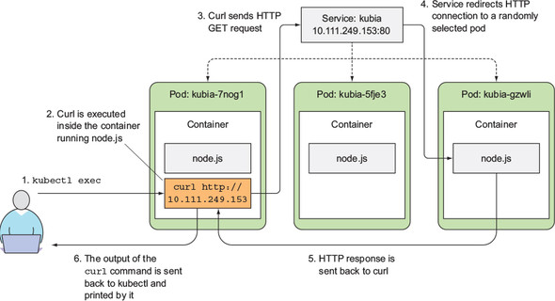
labels define the association
info@zekeLabs.com | www.zekeLabs.com | +91 8095465880

Slide 12
Service endpoints
An Endpoints resource is a list of IP addresses and ports exposing a service.
Selector is used to build a list of IPs and ports, which is then stored in the Endpoints resource.
When a client connects to a service, the service proxy selects one of those IP and port pairs and redirects the incoming connection to the server listening at that location.
You can specify the external endpoints by specifying them as in external-service-endpoints.yaml

Slide 13
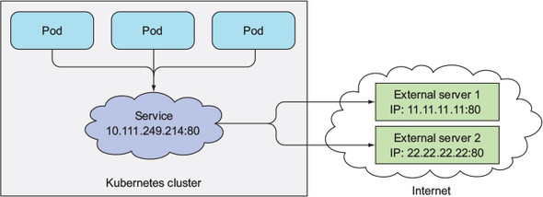
External Service endpoints
To create external endpoints first create a service without selector as in external-service.yaml
You can then specify “external endpoints” by specifying them as in external-service-endpoints.yaml
The name of the service must match the name of the Endpoints object

Slide 14
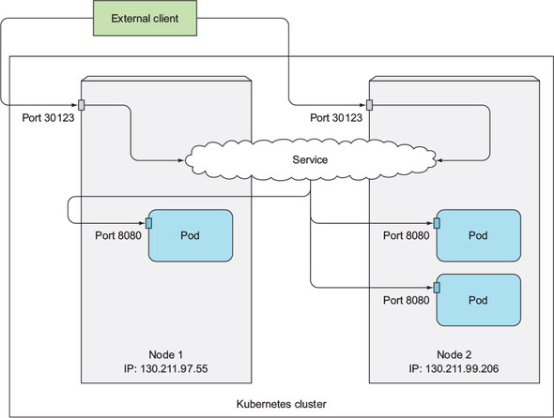
Nodeport

Slide 15
Session affinity
Kubernetes supports only two types of service session affinity: None and ClientIP.
It doesn’t have a cookie-based session affinity option, because Kubernetes services don’t operate at the HTTP level.
Services deal with TCP and UDP packets and don’t care about the payload they carry.
SessionAffinity:ClientIP makes the service proxy redirect all requests originating from the same client IP to the same pod.
kind: Service spec: sessionAffinity: ClientIP ...

Slide 16
Ingress
Kubia-ingress.yaml
To access your service through http://kubia.example.com, you’ll need to make sure the domain name resolves to the IP of the Ingress controller.
...

Slide 17
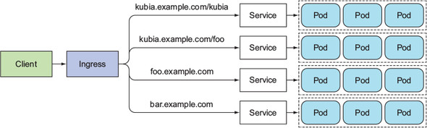
Ingress service

Slide 18
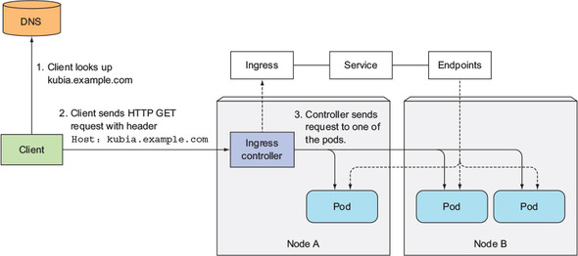
Ingress service

Slide 19
Troubleshooting connectivity to pods through service
Make sure you’re connecting to the service’s cluster IP from within the cluster, not from the outside.
Don’t bother pinging the service IP to figure out if the service is accessible (remember, the service’s cluster IP is a virtual IP and pinging it will never work).
If you’ve defined a readiness probe, make sure it’s succeeding; otherwise the pod won’t be part of the service.
To confirm that a pod is part of the service, examine the corresponding Endpoints object with kubectl get endpoints.
Check whether you’re connecting to the port exposed by the service and not the target port.
Try connecting to the pod IP directly to confirm your pod is accepting connections on the correct port.

Slide 20
THANK YOU
Let us know how can we help your organization to Upskill the employees to stay updated in the ever-evolving IT Industry.
Get in touch:
www.zekeLabs.com | +91-8095465880 | info@zekeLabs.com
Visit : www.zekeLabs.com for more details

